Slide 1
Democracy as propaganda for Capitalism
Justin Murphy, PhD
University of Southampton
jmrphy.net
@jmrphy

Slide 2
Most People think Propaganda is a tendency of authoritarian governments.

Slide 3


Slide 4
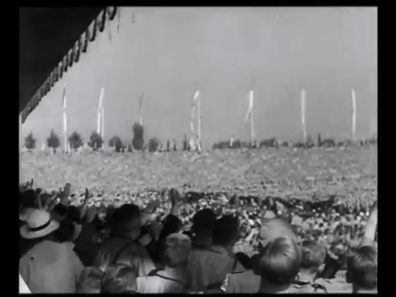

Slide 5


Slide 6
On the other hand, Most People Think
Free and open exchange of ideas is the tendency
Of Liberal / Capitalist/ Democratic governments.

Slide 7


Slide 8
This is wrong.
I will make the following arguments:
Modern mass propaganda was invented under liberal capitalism.
Indeed, the notion of “Democracy” is perhaps the most successful piece of propaganda ever deployed; to the benefit of corporate and state elites seeking to silence the actual movement of real democracy.
2. Exciting new research using new data and new methods generates some unexpected evidence for this perspective.

Slide 9
1. Modern MASS Propaganda was invented under Liberal Capitalism
The first nation-wide, systematic manipulation of public opinion was by the United States government in WW1.
The U.S. public was strongly opposed to entering WWI.
After election (1916), the Wilson administration decides to enter.
Wilson administration conducts a systematic propaganda campaign.
Committee on Public Information, aka the Creel Commission.

Slide 10
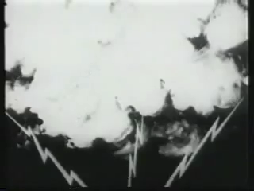

Slide 11
1. Modern MASS Propaganda was invented under Liberal Capitalism
The first nation-wide, systematic manipulation of public opinion was by the United States government in WW1.
The U.S. public was strongly opposed to entering WWI.
After election (1916), the Wilson administration decides to enter.
Wilson administration conducts a systematic propaganda campaign.
Committee on Public Information, aka the Creel Commission.
This launches the propaganda of “Democracy” as a good thing states would now claim to be.
Hitherto, “democracy” had always meant “chaos” & states were there to prevent it. It had always been a pejorative, much like how many people say “anarchy” today.

Slide 12


Slide 13
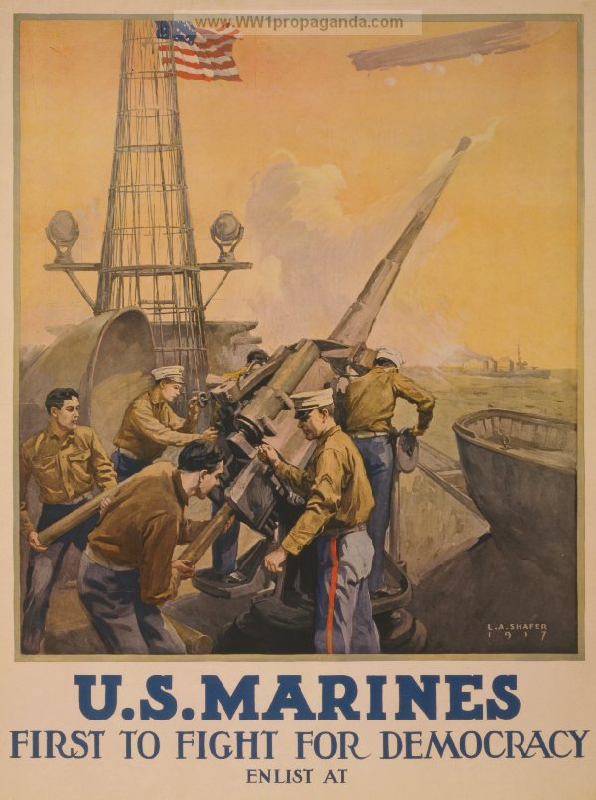

Slide 14


Slide 15
Let’s look Deeper Into the Fossil Record.

Slide 16
Percentage of books containing each word per year, based on a sample of about 4% of all books, via Google’s “Ngram” database.

Slide 17
1. Modern MASS Propaganda was invented under Liberal Capitalism
The first nation-wide, systematic manipulation of public opinion was by the United States government in WW1.
The U.S. public was strongly opposed to entering WWI.
After election (1916), the Wilson administration decides to enter.
Wilson administration conducts a systematic propaganda campaign.
Committee on Public Information, aka the Creel Commission.
This launches the propaganda of “Democracy” as a good thing states would now claim to be.
Hitherto, “democracy” had always meant “chaos” & states were there to prevent it. It had always been a pejorative, much like how many people say “anarchy” today.
Also launches the propaganda equation “nation = business”
Therefore “unions = bad for the nation.”
Workers were largely opposed to the “rich man’s war.”

Slide 18
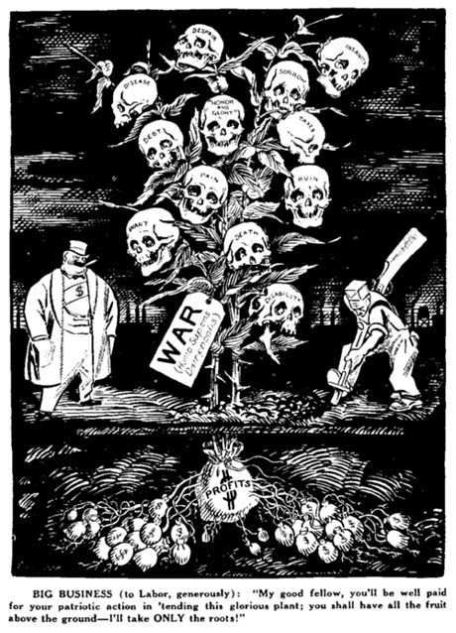

Slide 19


Slide 20
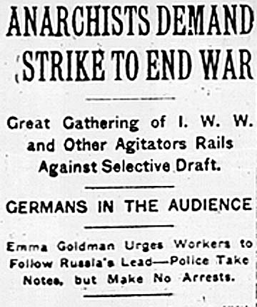

Slide 21


Slide 22
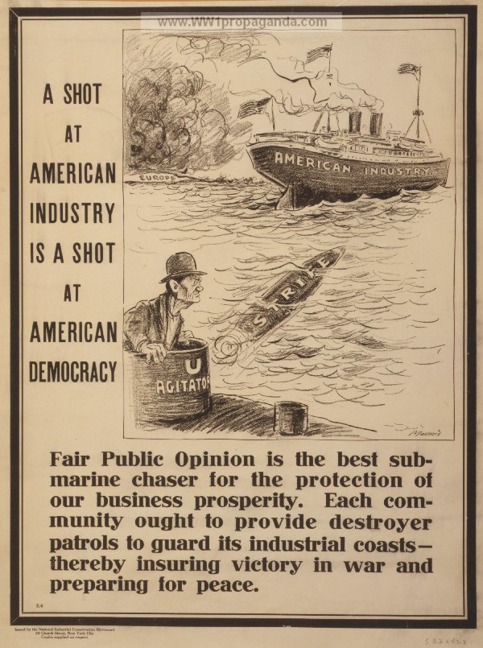

Slide 23
2. Current Research
Two interesting, recent pieces which are curiously supportive of my argument (although they don’t quite frame their findings this way!)
Western television entering into East Germany made East Germans more satisfied with their authoritarian government (Kern and Hainmueller 2009).
- Natural experiment exploiting topography
- Survey data, exit visas, and government documents
B. The more mass media in a country, the less likely is a civil war to occur (Warren 2014).
- This is true controlling for level of democracy
- This is true controlling for media freedom

Slide 24
Conclusion
1. Historically, modern mass propaganda is first and foremost a product of liberal, capitalist government rather than authoritarian government.
2. “Democracy” as we know it today, as an international ideal of what states claim to be, was only born as propaganda for capitalism.
“Democracy” was launched quite explicitly to silence the organic, militant “democracy” of workers and radicals trying to overthrow capitalism and resist the “rich man’s war.”
3. New data and advanced research methods are possibly suggesting interesting new evidence for this perspective.
Slides and bibliography available at jmrphy.net. Thanks!

